Slide 1


Flight Delay Predictions
Midterm Project
Peter Krejcar
Daniel Villamil

Slide 2

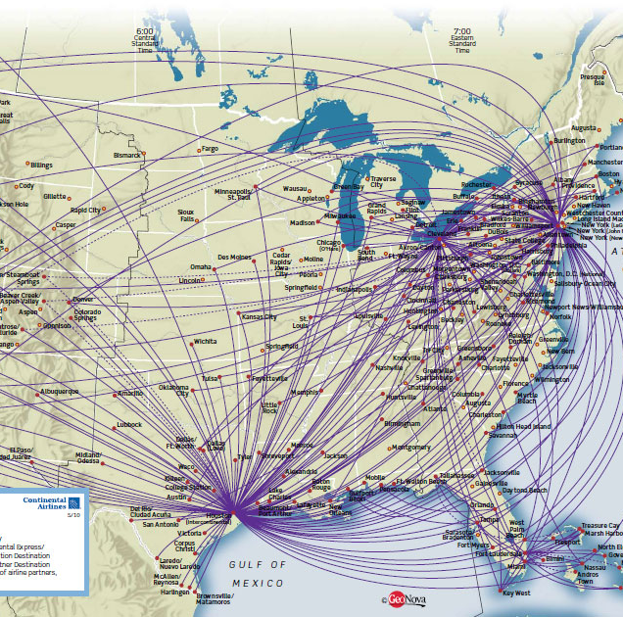
Complex Network of Flights and Airports
Many factors to consider.
Additional costs:
Unproductive airplanes
Unproductive clients
How to measure the network effect
When too much noise, what to ignore?

Slide 3

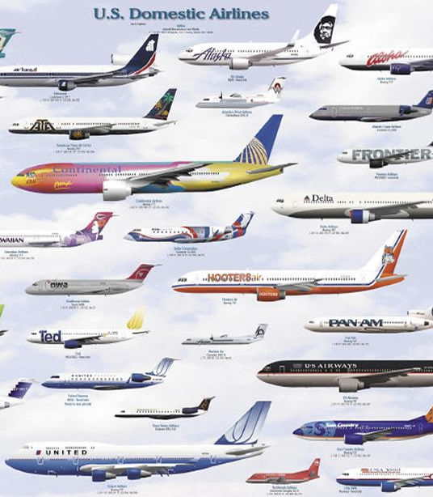

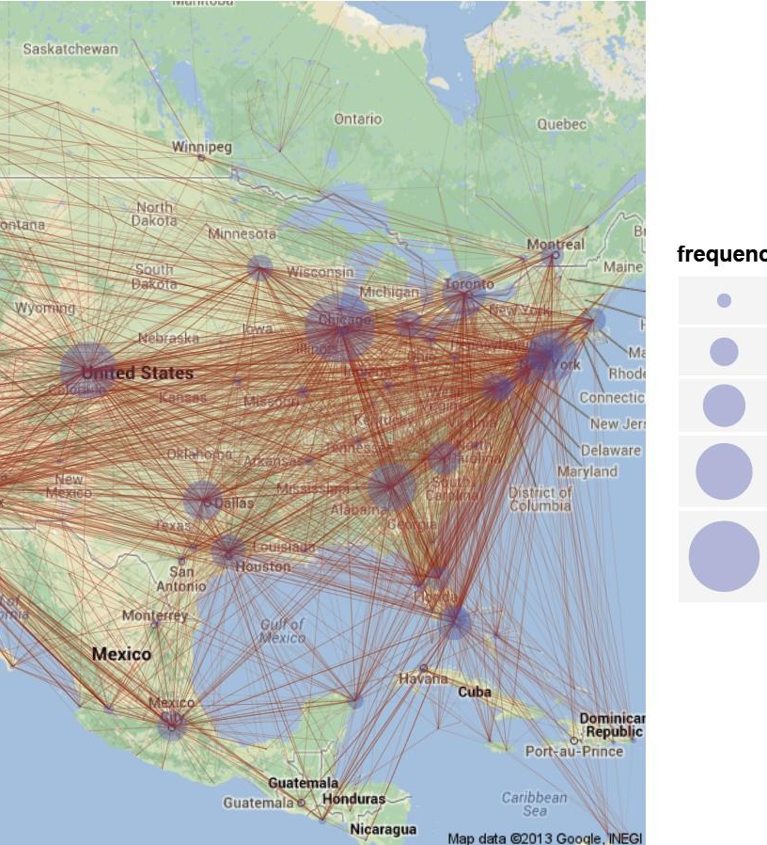
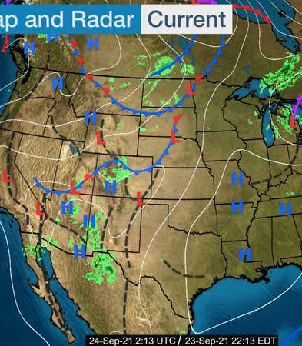
Relevant Features
Flights and Passengers:
Where (from/to)
With whom
When
For how long
Externalities:
Weather

Slide 4
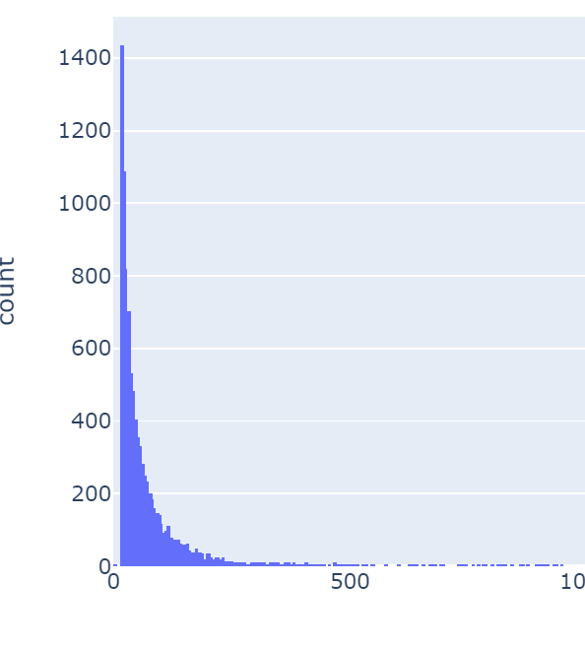
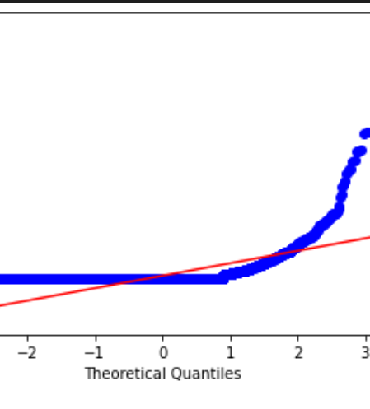
Analyzing the Data
Linear models won’t do well with this
Alternatives:
Log transform
Scale it
Feature engineering
Non Linear models
This is not normal

Slide 5
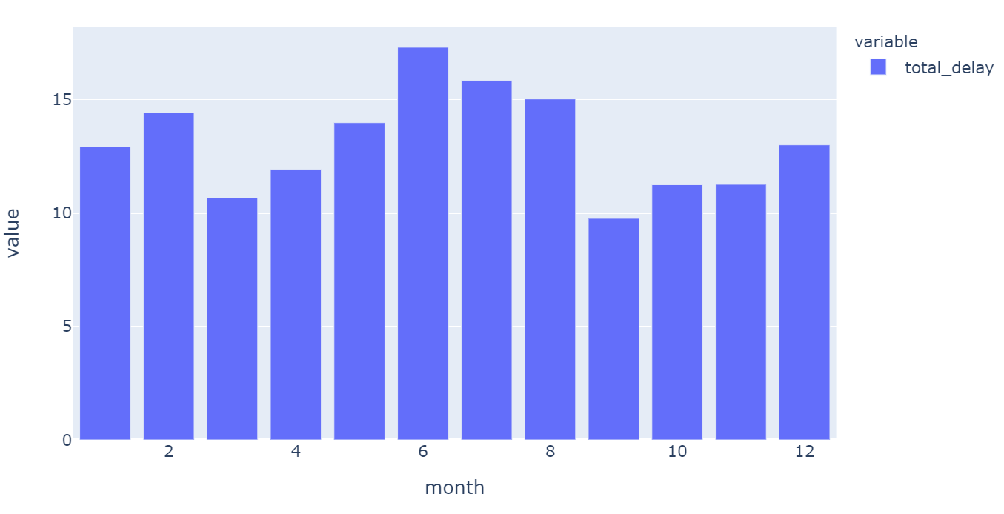
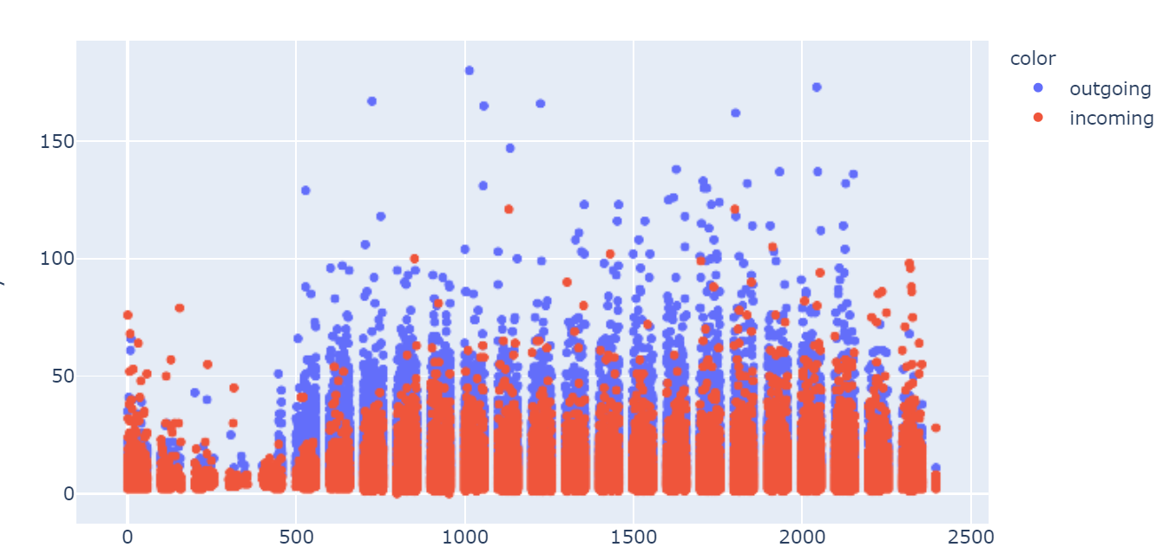
Seasonality
Peak months
Peak days of the week
Peak hours of the day
Weekends
Holiday Season

Slide 6
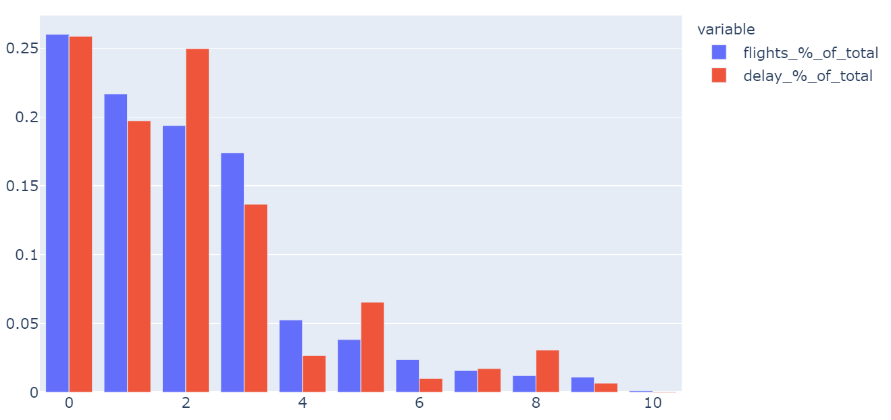
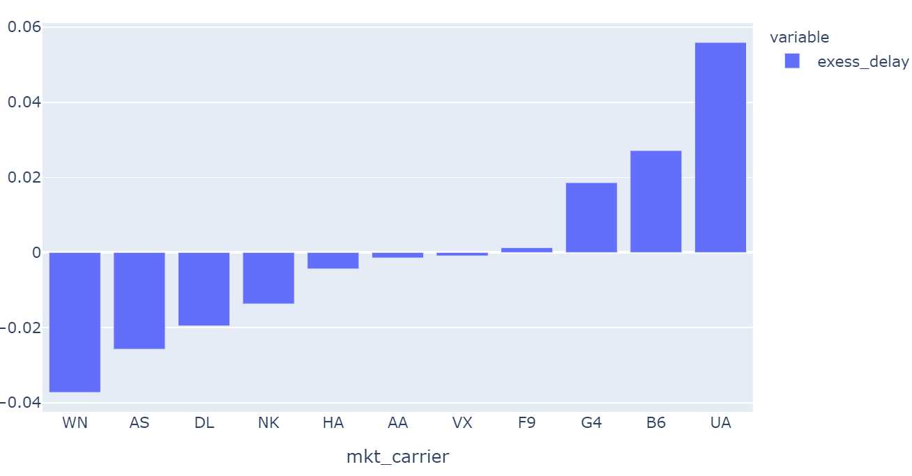
Carriers
Market participation:
By volume of flights
By Volume of delays
Some carriers have more/less than proportional delays respect to their size

Slide 7
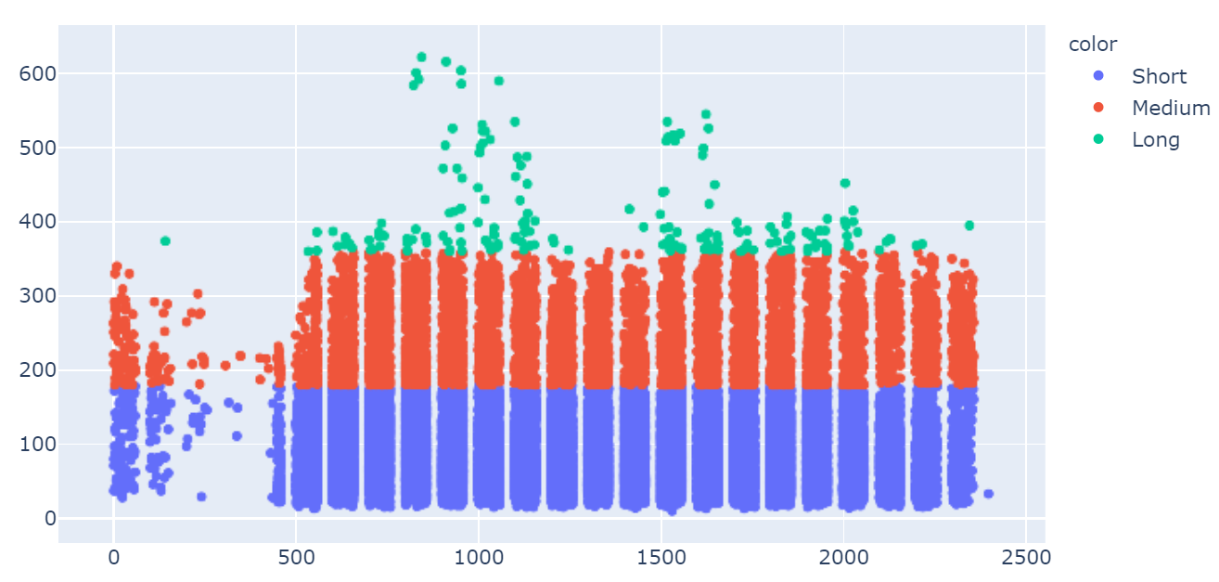
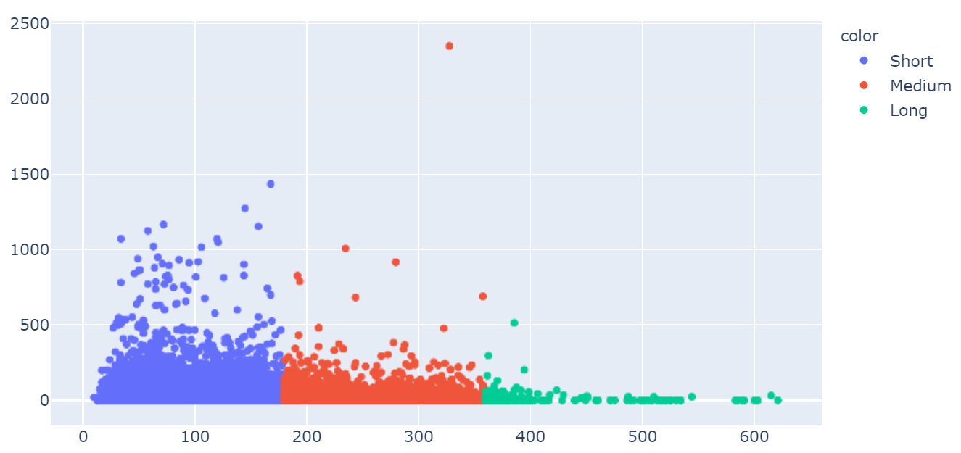
Distance
Hour of day Vs. Airtime
Longer flights start in peak hours
But! The longer the flight, the less likely to be late
Airtime Vs. Delays

Slide 8
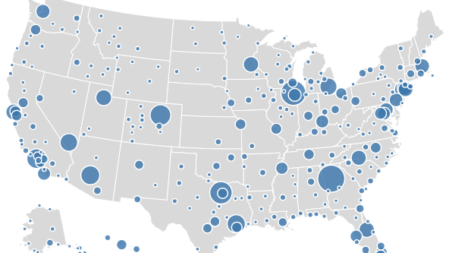
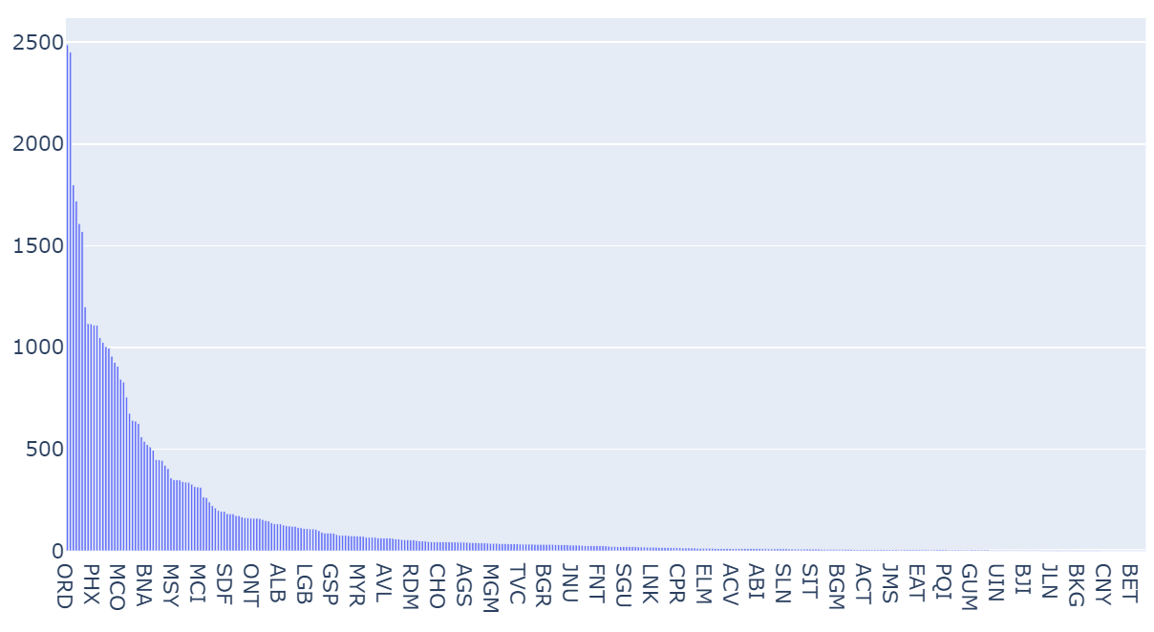
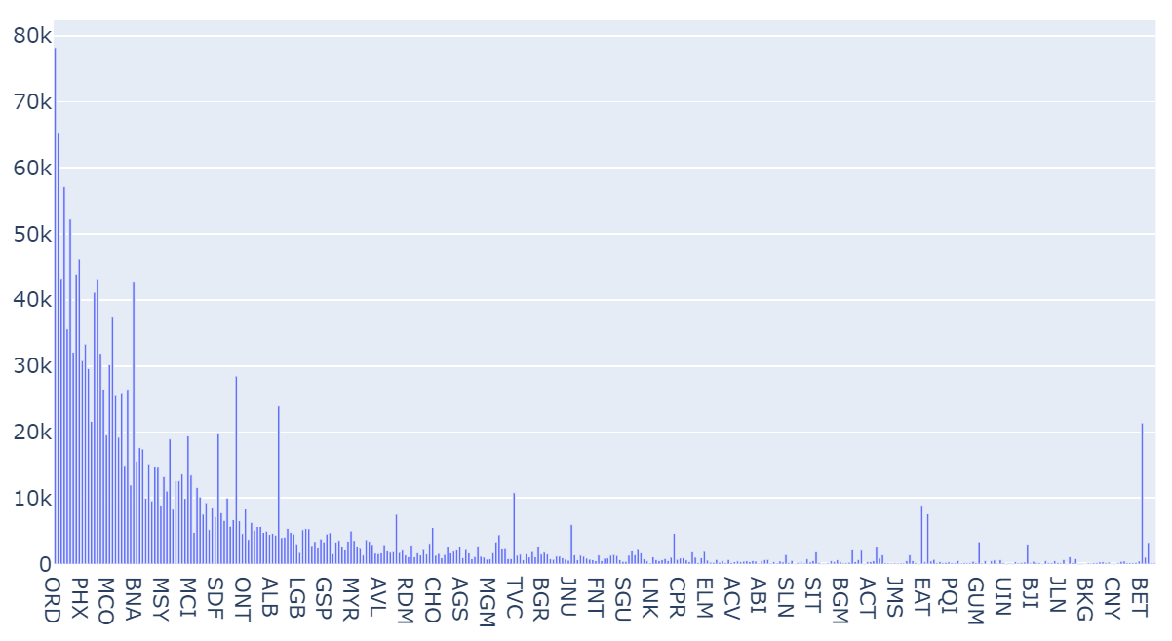
Airports
The highest volumes
Per Flights
Per number od passengers

Slide 9

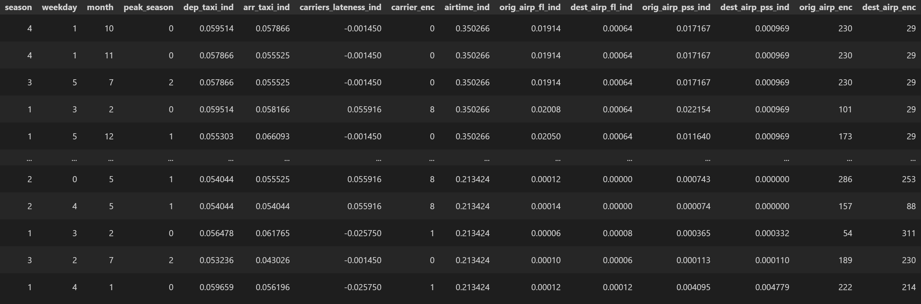
Feature Engineering
Capture the effect of correlations observed above:
Seasonality
Peak Hours
Flight length
‘Slow’ Airlines
High Traffic Airports
Bad weather
Getting rid of the noise

Slide 10
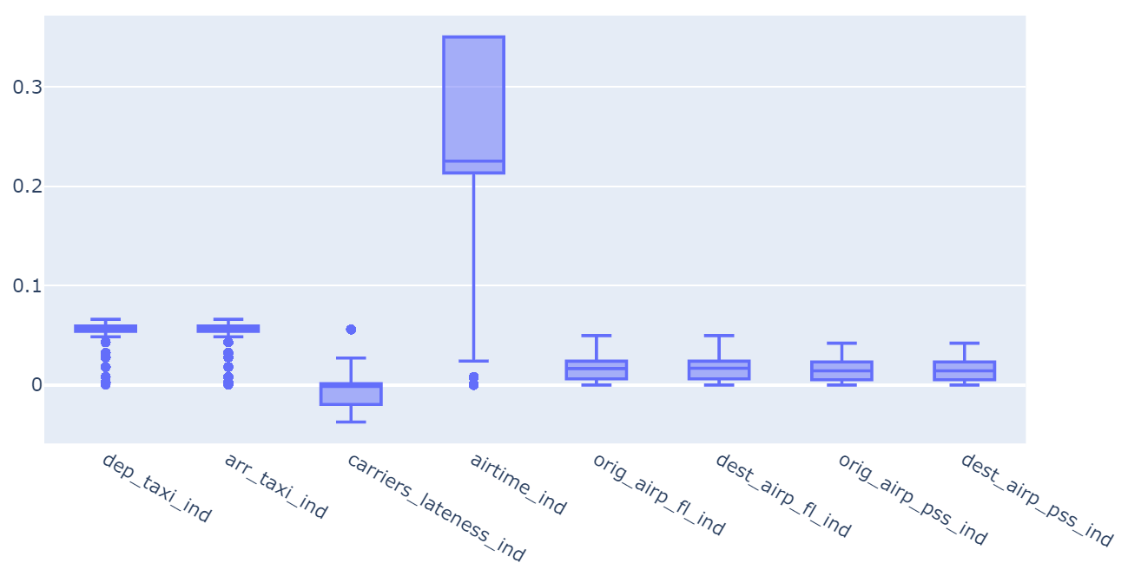
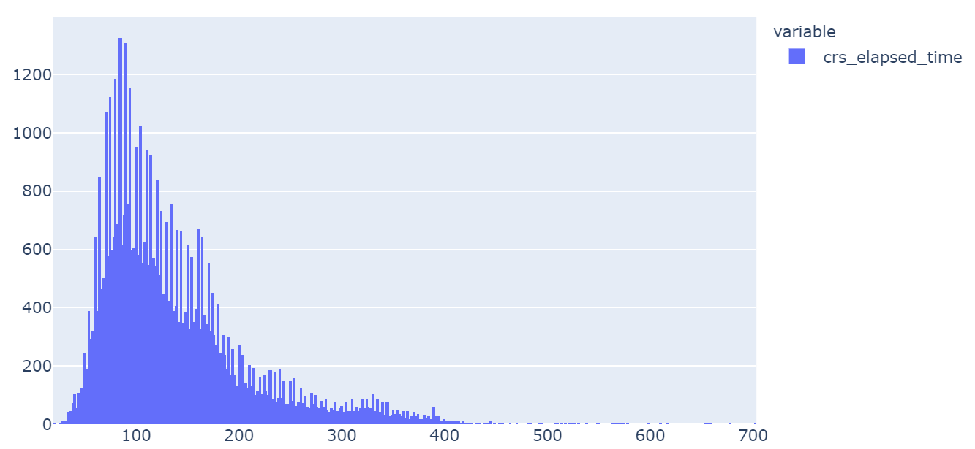
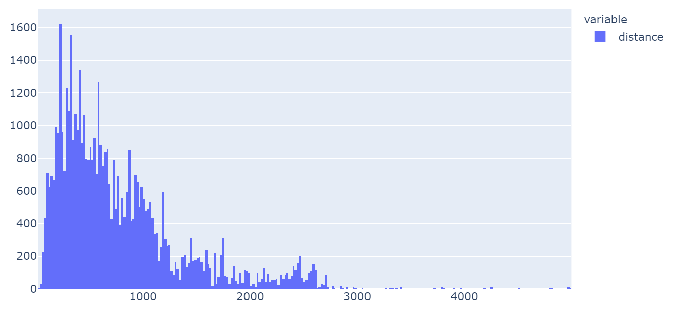
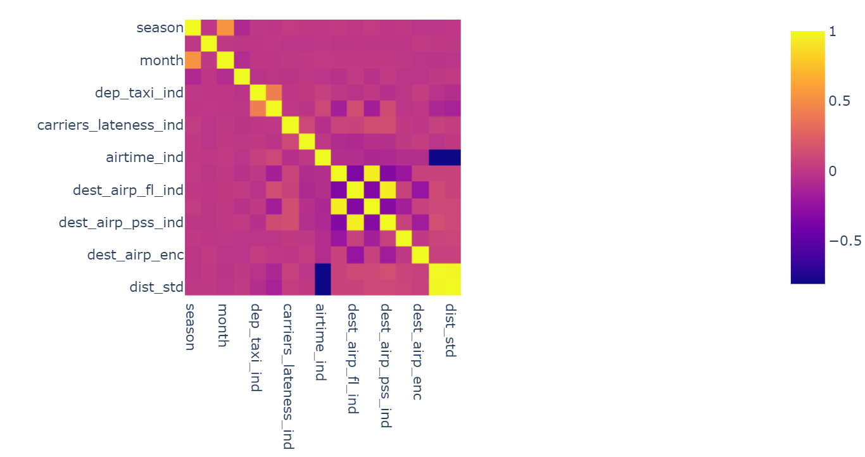
Feature Selection
Outlier Deletion
Dropbox
Histograms
Low Variance
High Correlation between features

Slide 11
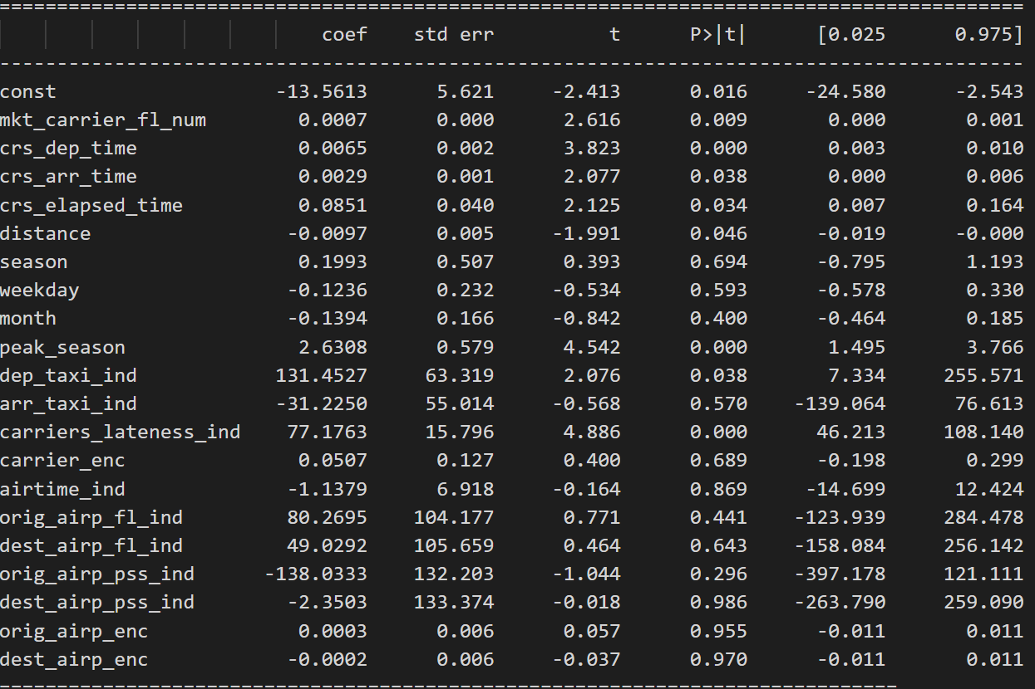
Feature Selection
Using Algorithms:
Forward Selection
FS – Linear Reg
FS – Random Forest
Dropping high p-values (if it makes sense)
Creating new features

Slide 12

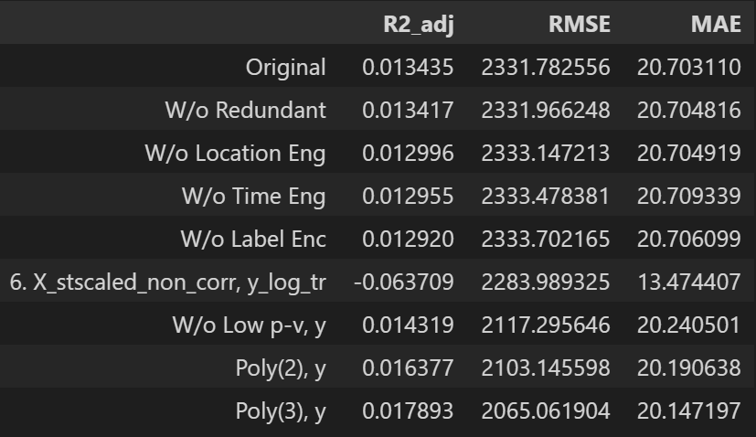
Modeling
Linear Regression
Multiple combinations
Standardized
Log Transformed
Polynomial
Filtered

Slide 13

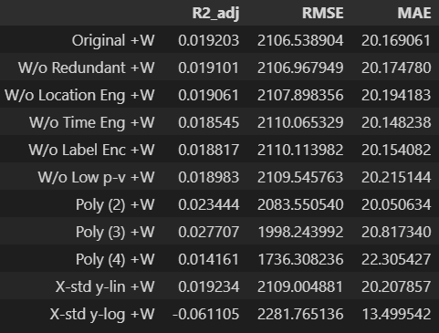
Modeling
OLS with weather:
Multiple combinations
Standardized
Log Transformed
Polynomial
Filtered

Slide 14

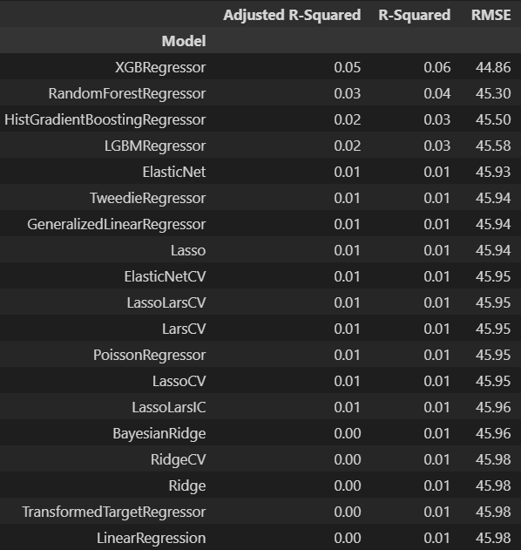

Modeling
Linear Regression:
Expected to do badly.
Data is not normal
Needed to add weather
Other models:
Best Candidates:
XGBoost
Random Forest

Slide 15

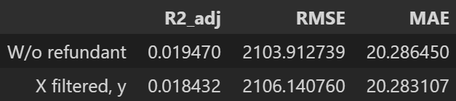
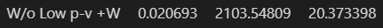
Modeling
Random Forest
Original
Filtered
With weather
Different param

Slide 16

Conclusions
Setbacks:
Scaling made it worse
LR not fit for the task
Garbage in, garbage out?
Solutions:
Reduce redundancies (corr)
Back to square 1:
Feature engineering
Transformation
Other non-linear models

